Slide 1

More Than You Think
HL7 is people, HL7 is ideas, HL7 is collaboration

Slide 2
Healthcare Standards
Complex…. Slow…
Hard to use and understand
Require specialist skills, tools
Costly

Slide 3
Healthcare Standards
Complex…. Slow…
Hard to use and understand
Require specialist skills, tools
Costly
What if it didn’t have to be like that?

Slide 4
Introducing FHIR
Fast Health Interoperability Resources
Pronounced “Fire”
Based on industry best practices, with a focus on simplicity and implementability
…insert your fire related joke here….

Slide 5
Resources
Resources are:
“Things” that live on the web
Read/updated etc via HTTP
Known content and meaning
Identity (= location) – can be moved
Represented in XML or JSON (or others)
Molecules to build useful systems

Slide 6
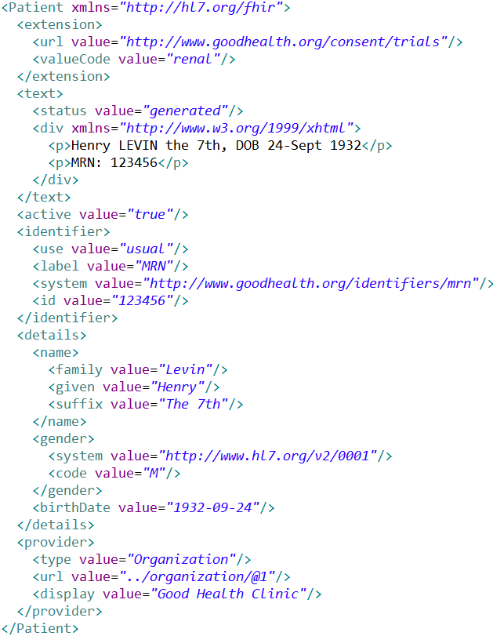
Extension with reference to its definition
Human Readable
Summary
Standard Data Content:
MRN
Name
Gender
Date of Birth
Provider

Slide 7
Resources have 3 parts
Defined Structured Data
The logical, common contents of the resource
Mapped to formal definitions/RIM & other formats
Extensions
Local requirements, but everyone can use
Published and managed
Narrative
Human readable (fall back)

Slide 8
Kinds of Resources
Administrative Concepts
Person, Patient, Organization, Device, Facility
Coverage, Invoice, etc.
Clinical Concepts
Allergy, Problem, Medication, Family History
Care Plan
Infrastructure Functionality
Document, Message, Conformance/Profiling

Slide 9
Using Resources
Classic Web RESTful approach
Simple approach led by Facebook, Twitter, etc.
Bundles – use Atom to group them
Internet syndication (publish/subscribe)
Messages (~v2), Documents (~CDA)
Custom Services (SOA)
Same content / base rules
Portability

Slide 10
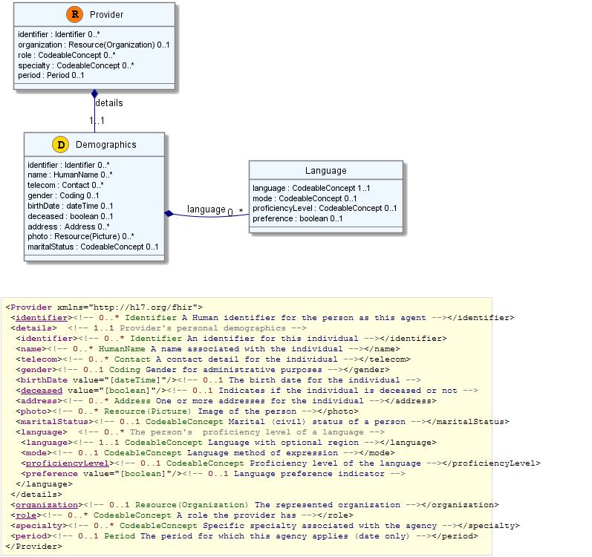

Slide 11
FHIR Ethos
Simplicity / Web alignment
Implementation focused
Reference Implementations (C#, Java, etc)
Publically available test servers (now)
Connectathons
Freely available
http://hl7.org/fhir
Unencumbered – free for anyone to use

Slide 12
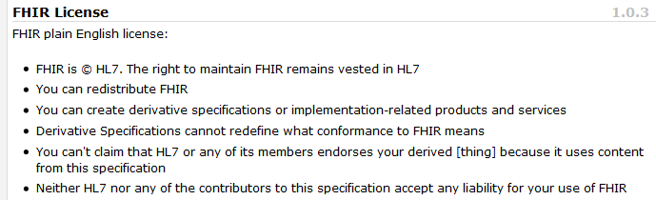
License

Slide 13
Extensions
Managing extensibility is a central problem
Everyone needs extensions, everyone hates them
FHIR tames extensibility
Built in extensibility framework (engineering level)
Define, publish, find extensions
Use them
This tames the overall specification

Slide 14
Progress
Enthusiastic Community Adoption
Geometric Growth in Connectathons
Recognition at HITSC & other national programs
Candidate and Prototype programs
Data Collection / Specification
Exchange & Integration
Analysis

Slide 15
Collaborations
Harvard Clinical Genomics resources:
Sequences
Diagnostics
Genome Expression
Analysis
Progression towards full standard

Slide 16
Future Plans
Internal preparation phase
Very solid infrastructure (implementation focus)
More work required still
September ballot cycle – DSTU
DSTU = Draft Standard for Trial Use
Publish FHIR as full DSTU end 2013

Slide 17
Follow Up
Read the spec: http://hl7.org/fhir
Follow #FHIR on Twitter
Shape the specification:
Make comments online
Join the FHIR email list http://wiki.hl7.org/index.php?title=FHIR_email_list_subscription_instructions
Try implementing it
Come to the Connectathon!
Come to the next meeting (Atlanta in May)

Slide 18
FHIR
Simple…. FAST…
Easy to use and understand
Standard skills, tools
Cost-effective information sharing

